Slide 1
Chapter 3: RATIO AND PROPORTION
1. Number system
2. H.C.F and L.C.M
3. Averages
4. Percentages
5. Ratio and Proportion
6. Problems on Ages
7. Partnership
8. Allegation and Mixture

Slide 2
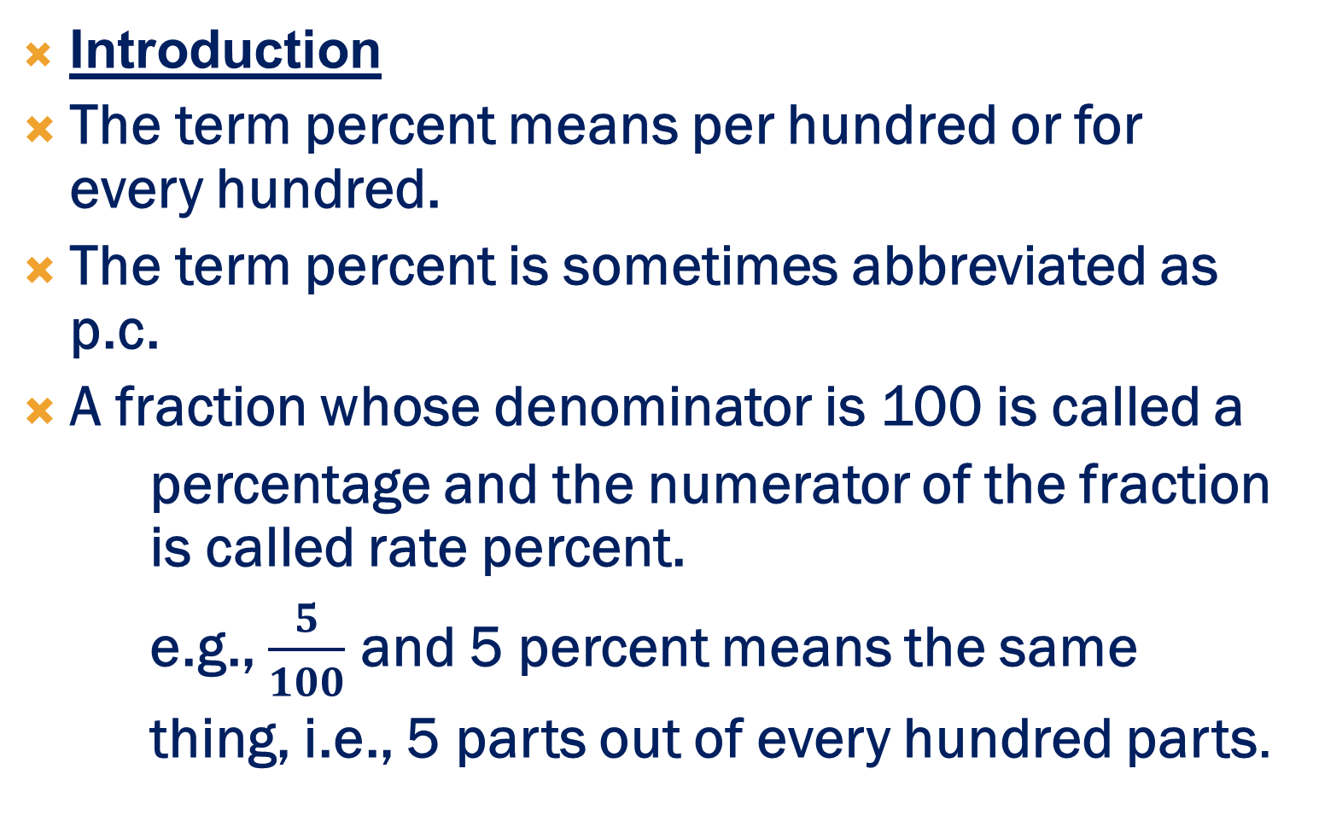
4. Percentages
Introduction
The term percent means per hundred or for every hundred.
The term percent is sometimes abbreviated as p.c.
A fraction whose denominator is 100 is called a
percentage and the numerator of the fraction is called rate percent.
e.g., $\frac{5}{100}$ and 5 percent means the same
thing, i.e., 5 parts out of every hundred parts.

Slide 3
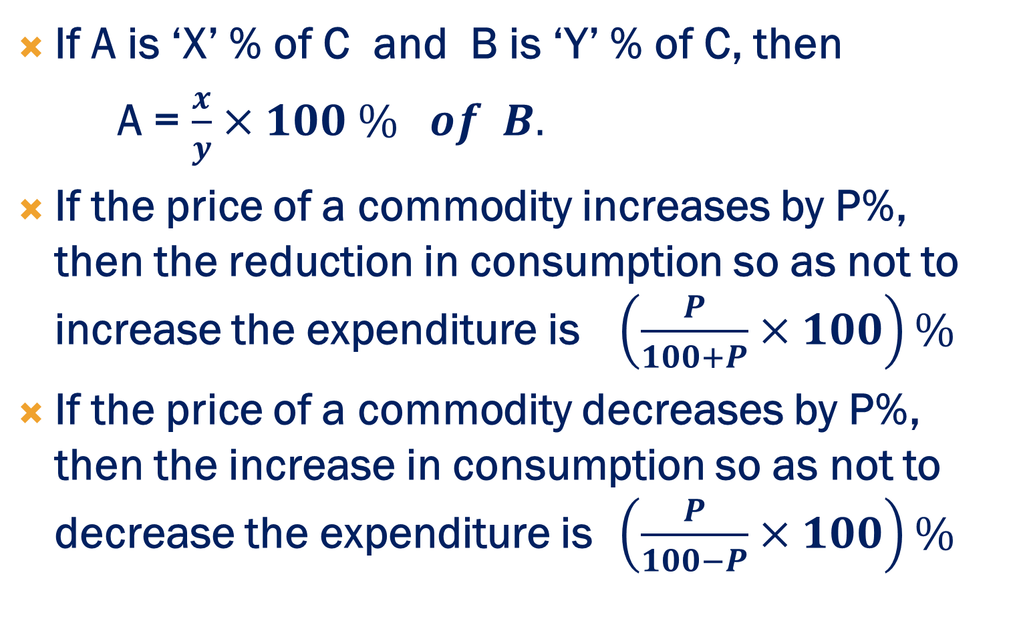
Basic Formulae
If A is ‘X’ % of C and B is ‘Y’ % of C, then
A = $\frac{x}{y}×100 \% of B.$
If the price of a commodity increases by P%, then the reduction in consumption so as not to increase the expenditure is $\left(\frac{P}{100+P}×100\right)\%$
If the price of a commodity decreases by P%, then the increase in consumption so as not to decrease the expenditure is $\left(\frac{P}{100−P}×100\right)\%$

Slide 4
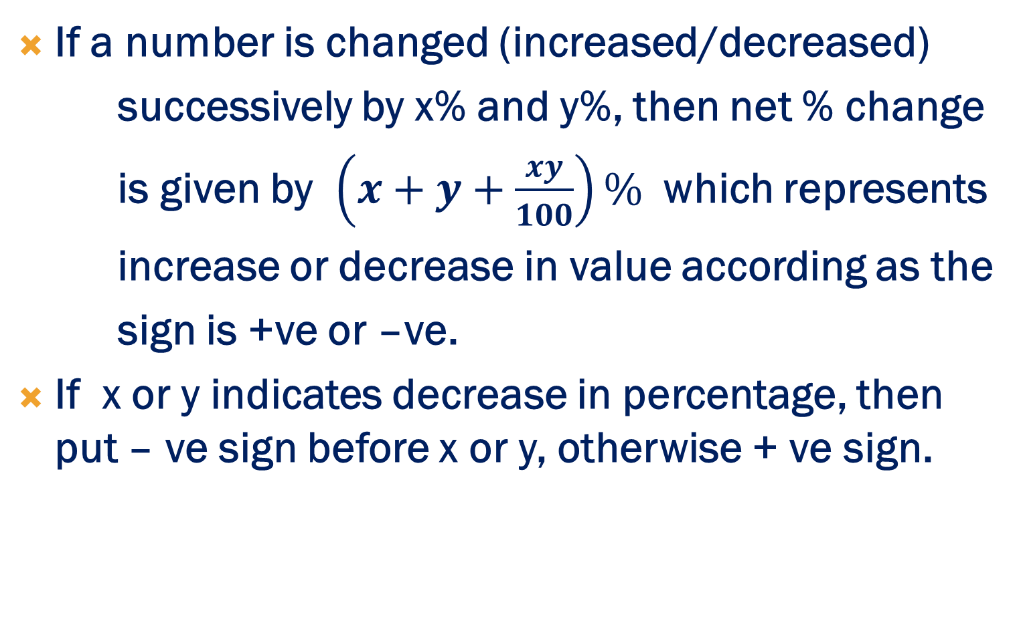
Basic Formulae
If a number is changed (increased/decreased)
successively by x% and y%, then net % change
is given by $\left(x+y+\frac{xy}{100}\right)\%$ which represents
increase or decrease in value according as the
sign is +ve or –ve.
If x or y indicates decrease in percentage, then put – ve sign before x or y, otherwise + ve sign.

Slide 5
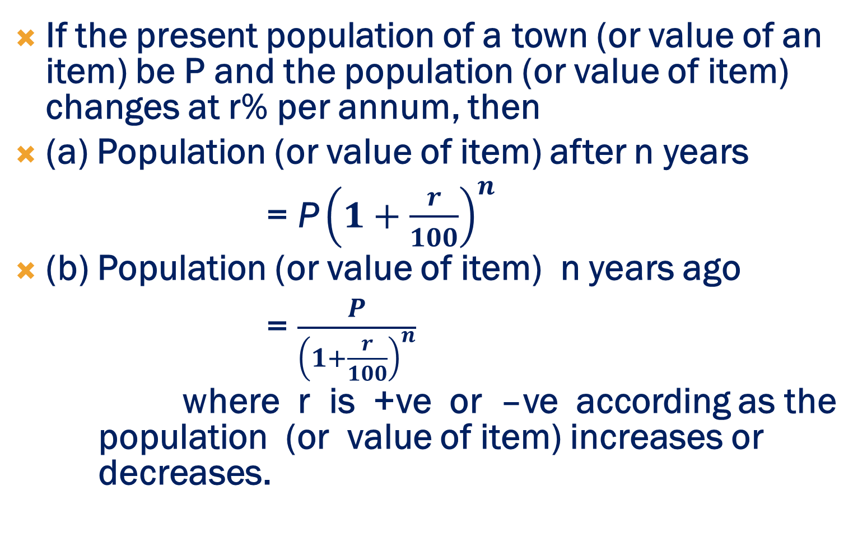
Basic Formulae
If the present population of a town (or value of an item) be P and the population (or value of item) changes at r% per annum, then
(a) Population (or value of item) after n years
= ${\text{P}\left(1+\frac{r}{100}\right)}^{n}$
(b) Population (or value of item) n years ago
= $\frac{P}{{\left(1+\frac{r}{100}\right)}^{n}}$
where r is +ve or –ve according as the population (or value of item) increases or decreases.

Slide 6
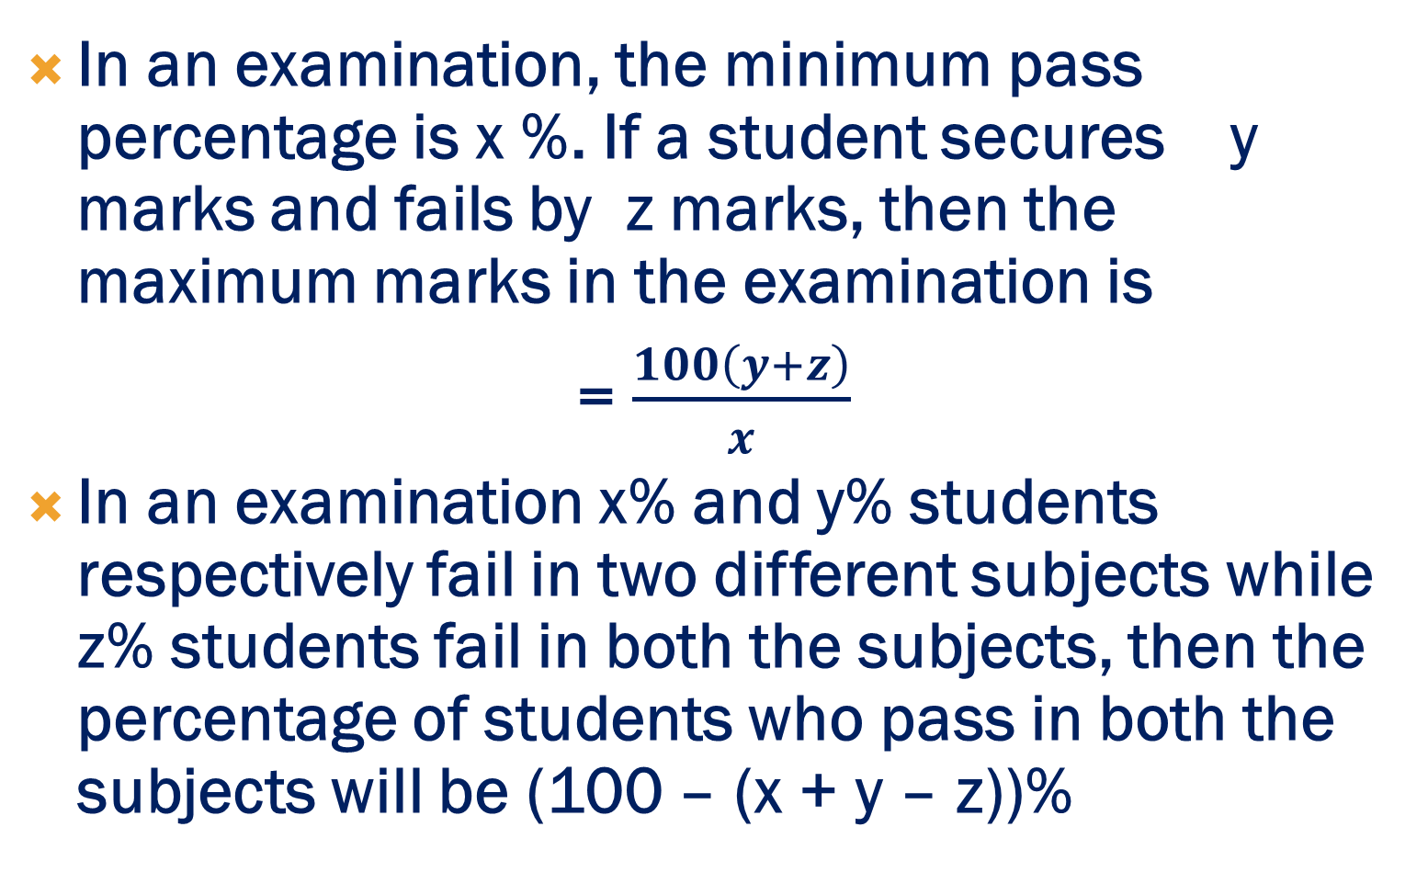
Basic Formulae
In an examination, the minimum pass percentage is x %. If a student secures y marks and fails by z marks, then the maximum marks in the examination is
= $\frac{100\left(y+z\right)}{x}$
In an examination x% and y% students respectively fail in two different subjects while z% students fail in both the subjects, then the percentage of students who pass in both the subjects will be (100 – (x + y – z))%

Slide 7
EXAMPLE PROBLEMS
1. Find a number whose 4% is 72.
(a) 1200
(b) 1400
(c) 1600
(d) 1800

Slide 8
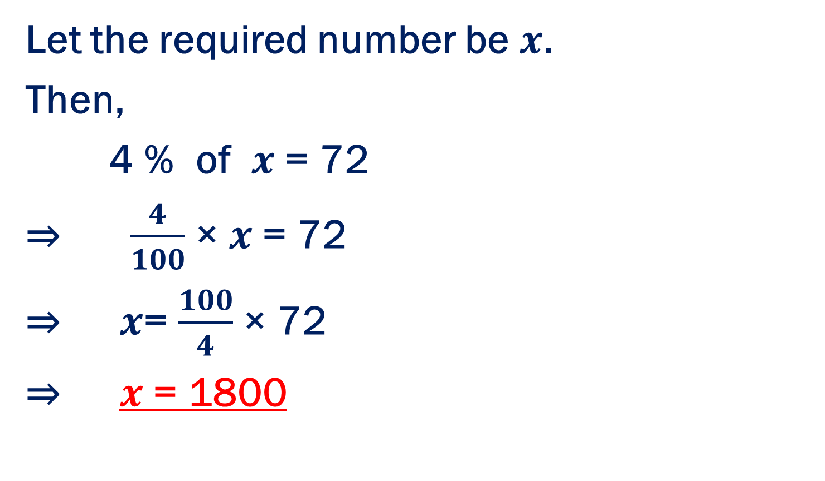
SOLUTION : OPTION (D)
Let the required number be $x$.
Then,
4 % of $x$ = 72
⇒ $\frac{4}{100}$× $x$= 72
⇒ $x$= $\frac{100}{4}$× 72
⇒ $x$= 1800

Slide 9
2. In an examination, a student must get 60% marks to pass. If a student who gets 120 marks, fails by 60 marks, find the maximum marks.
(a) 200
(b) 300
(c) 400
(d) 500

Slide 10
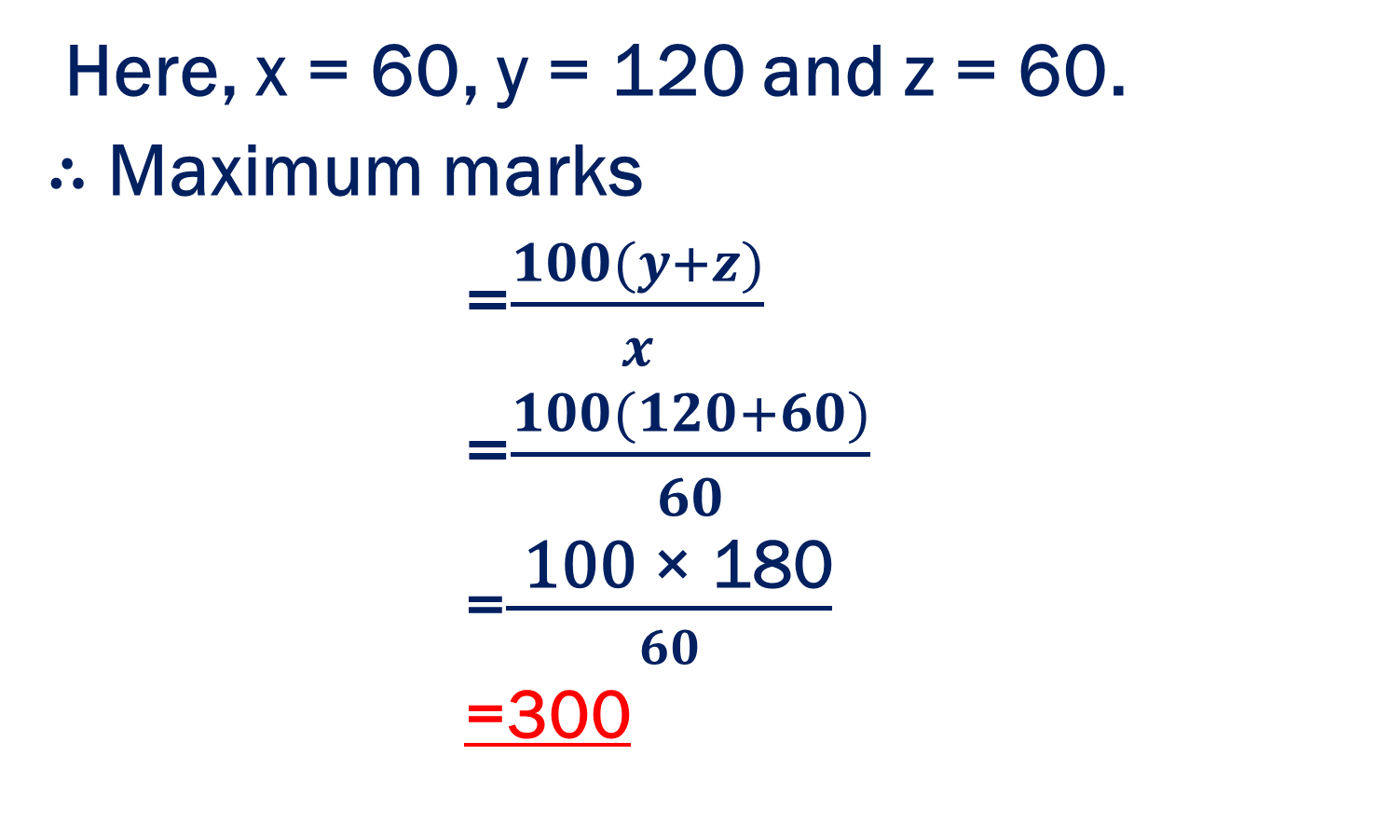
SOLUTION : OPTION (b)
Here, x = 60, y = 120 and z = 60.
∴ Maximum marks
=$\frac{100(y+z)}{x}$
=$\frac{100(120+60)}{60}$
=$\frac{\text{ 100 }\text{×}\text{ 180}}{60}$
=300

Slide 11
3. In an examination, 42% students failed in Mathematics and 52% failed in Science. If 17% failed in both the subjects, find the percentage of those who passed in both the subjects.
(a) 21 %
(b) 22 %
(c) 23 %
(d) 24 %

Slide 12
SOLUTION : OPTION (c)
Here, x = 42, y = 52 and z = 17.
∴ Percentage of students passing both the subjects
= (100 – (x + y – z))%
= (100 – (42 + 52 – 17))%
= 23%

Slide 13

4. What percentage is equivalent to 5 $\frac{1}{4}$ ?
(a) 525%
(b) 425%
(c) 625%
(d) None of these

Slide 14

SOLUTION : OPTION (a)
5 $\frac{1}{4}=\frac{21}{4}$
⇒ $\frac{21}{4}\text{×}100=525\%$

Slide 15


5. Express 8 $\frac{1}{3}$ % as a fraction.
(a) $\frac{1}{12}$
(b) $\frac{1}{16}$
(c) $\frac{1}{18}$
(d) None of these

Slide 16

SOLUTION : OPTION (a)
8 $\frac{1}{3}\%=$ $\frac{25}{3}\%$
⇒ $\frac{25}{3}\text{×}\frac{1}{100}=\frac{1}{12}$

Slide 17
6. 20% of 30% of 20% of rs.850 is:
(a) Rs.9.50
(b) Rs.10.20
(c) Rs.10.50
(d) None of these

Slide 18
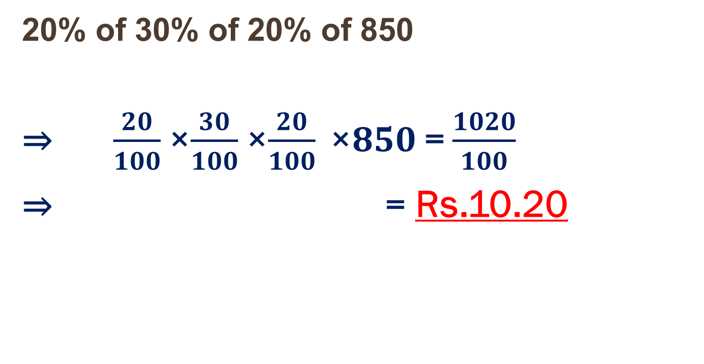
SOLUTION : OPTION (b)
20% of 30% of 20% of 850
⇒ $\frac{20}{100}$×$\frac{30}{100}$×$\frac{20}{100} \text{×}850$= $\frac{1020}{100}$
⇒ = Rs.10.20

Slide 19
7. The population of a town is decreased by 20% and 25% in two successive years. What per cent population is decreased after two years?
(a) 50 %
(b) 40 %
(c) 60%
(d) None of these

Slide 20
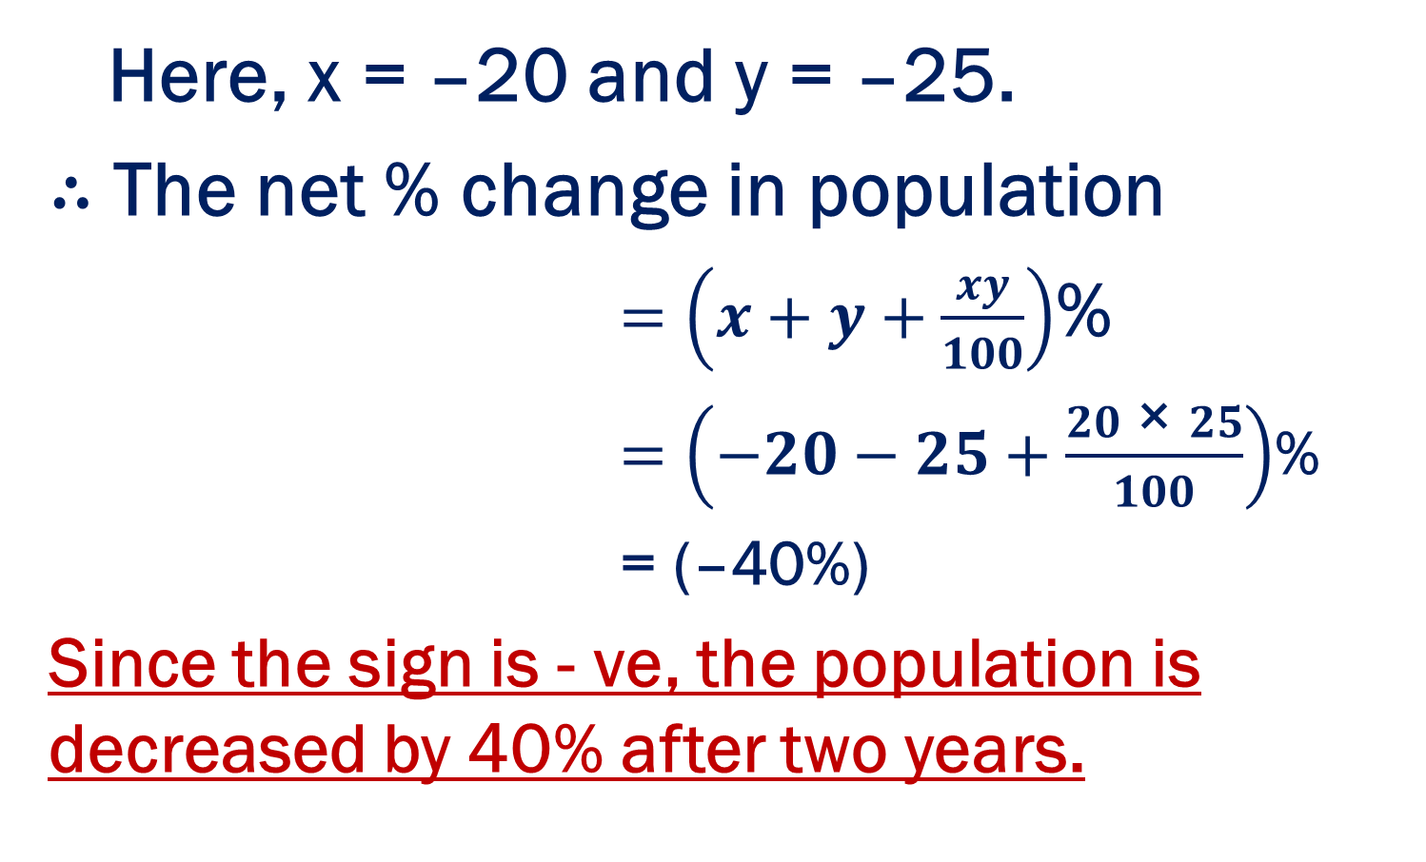
SOLUTION : OPTION (b)
Here, x = –20 and y = –25.
∴ The net % change in population
$=\left(x+y+\frac{xy}{100}\right)$%
$=\left(−20−25+\frac{20 \text{×} 25}{100}\right)$%
= (–40%)
Since the sign is - ve, the population is decreased by 40% after two years.

Slide 21
8. A shopkeeper marks the prices of his goods at 25% higher than the original price. After that, he allows a discount of 12%. What profit or loss did he make?
(a) 10% profit
(b) 15% profit
(c) 10% loss
(d) 15% loss

Slide 22
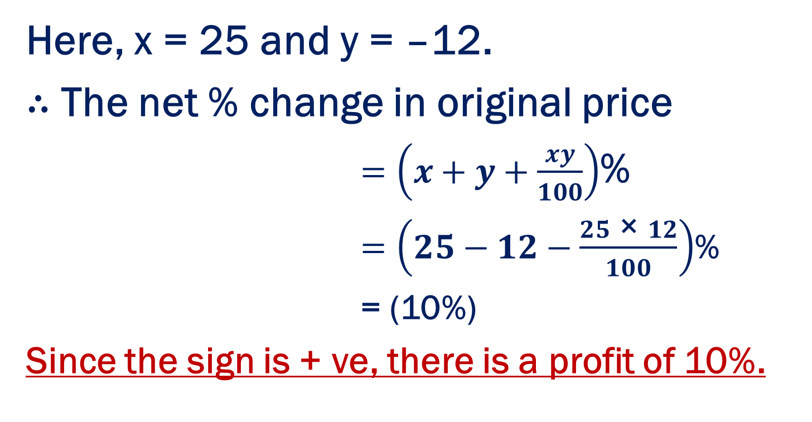
SOLUTION : OPTION (a)
Here, x = 25 and y = –12.
∴ The net % change in original price
$=\left(x+y+\frac{xy}{100}\right)$%
$=\left(25−12−\frac{25 \text{×} 12}{100}\right)$%
= (10%)
Since the sign is + ve, there is a profit of 10%.

Slide 23
EXErcise PROBLEMS
1.A number is increased by 20% and then decreased by 20%, the final value of the number:
(a) Does not change
(b) Decreases by 2%
(c) Increases by 4%
(d) Decreases by 4%.

Slide 24

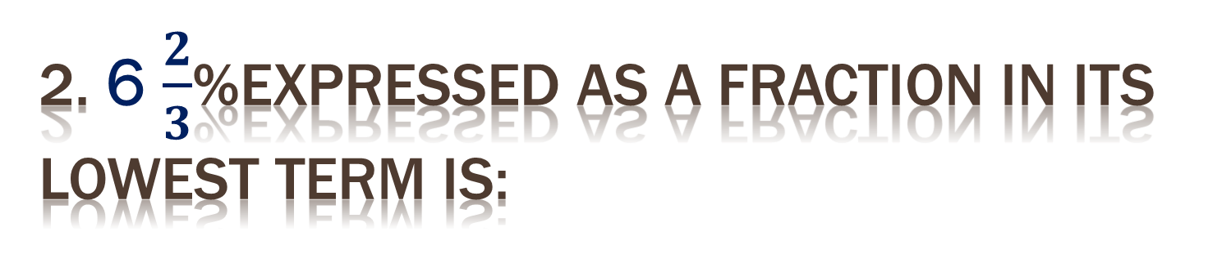
2. 6 $\frac{2}{3}$%expressed as a fraction in its lowest term is:
(a) $\frac{2}{15}$
(b) $\frac{1}{15}$
(c) $\frac{3}{20}$
(d) None of these

Slide 25
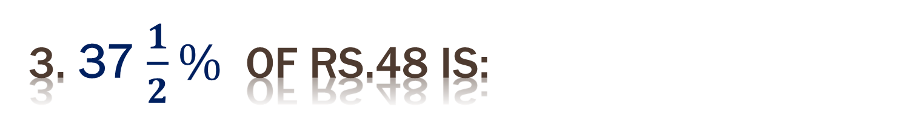
3. 37 $\frac{1}{2}\%$ of Rs.48 is:
(a) Rs.20
(b) Rs.16
(c) Rs.18
(d) None of these

Slide 26
4. ? × 15 = 37.5% of 220.
(a) 5.5
(b) 7.5
(c) 6.5
(d) None of these

Slide 27
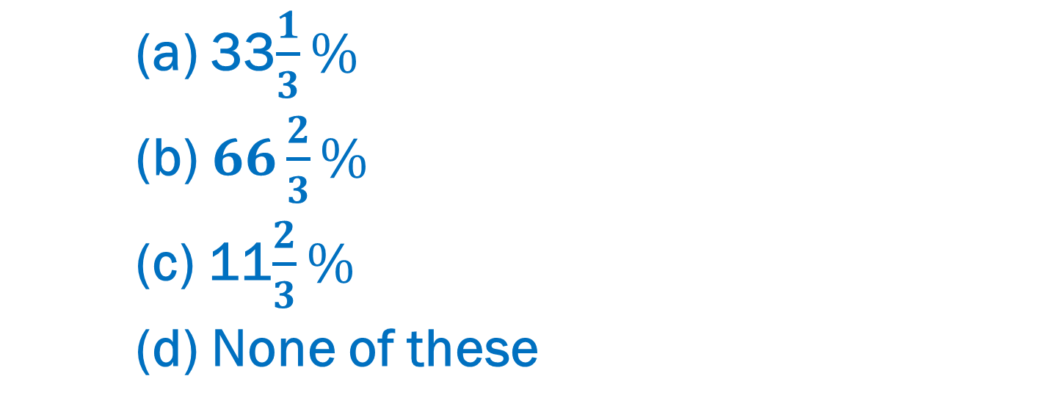
5. If A’s income is 25% less than that of B, then how much per cent is B’s income more than that of A?
(a) 33$\frac{1}{3}\%$
(b)$66\frac{2}{3}\%$
(c) 11$\frac{2}{3}\%$
(d) None of these

Slide 28
6. If 200% of a number is 90, then what is the 80% of that number?
(a) 48
(b) 36
(c) 24
(d) None of these

Slide 29
7. The difference between a discount of 35% and two successive discounts of 20% and 20% on a certain bill was rs.22. Find the amount of the bill.
(a) Rs.3200
(b) Rs.2200
(c) Rs.1800
(d) None of these

Slide 30
8. The radius of a sphere is increased by 10%. The surface area increases by
(a) 21 %
(b) 31 %
(c) 41 %
(d) None of these

Slide 31
you
Thank

